Slide 1
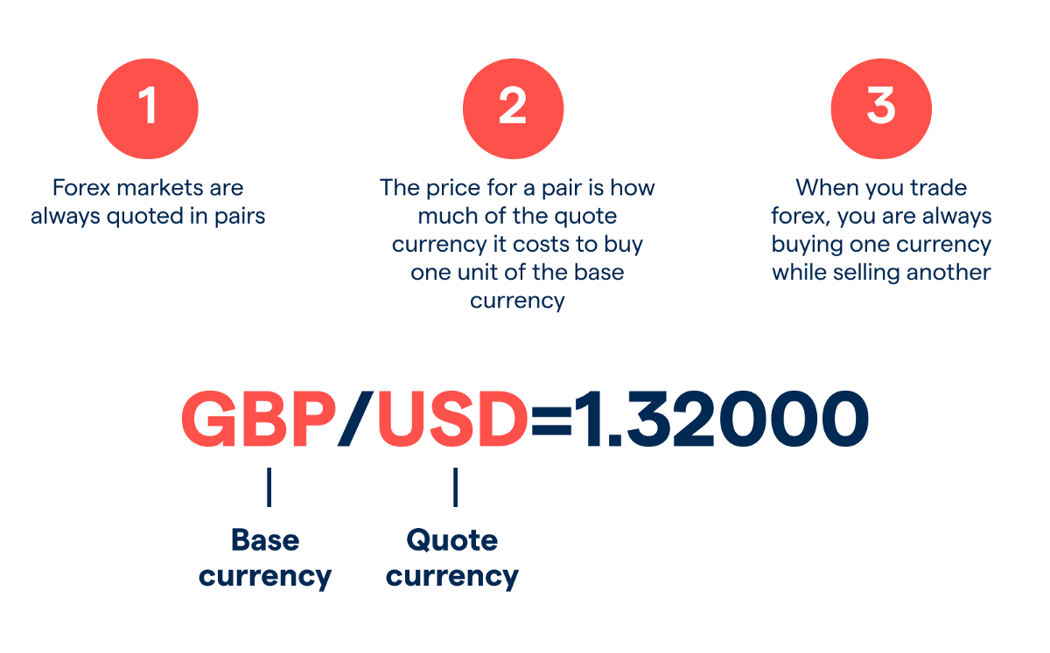
Currency Pairs in Forex

Slide 2
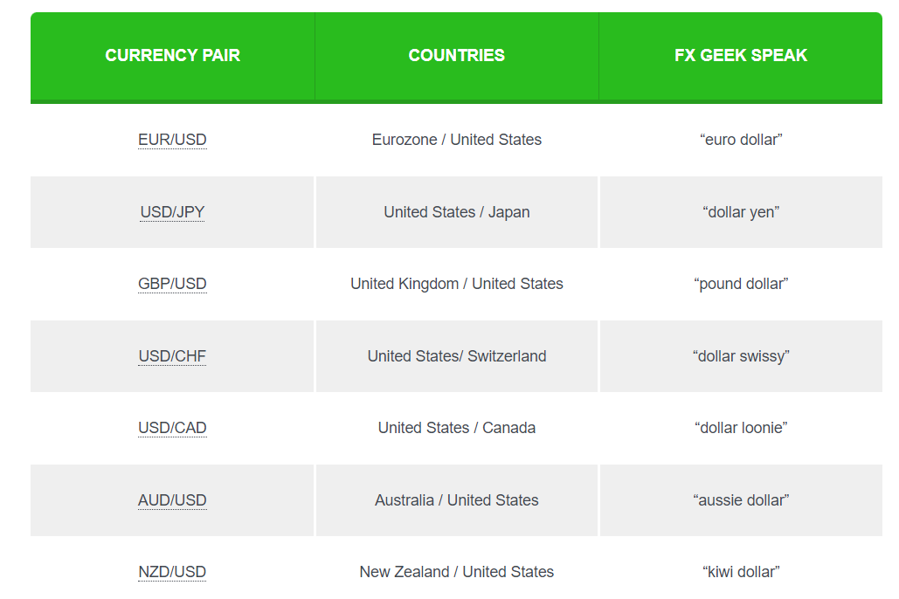
01)Major Currency Pairs
Currency pairs which contain USD and another
Major currency are called major currency pairs
Major currencies –
USD
EUR
JPY
GBP
NZD
AUD
CAD
CHF

Slide 3
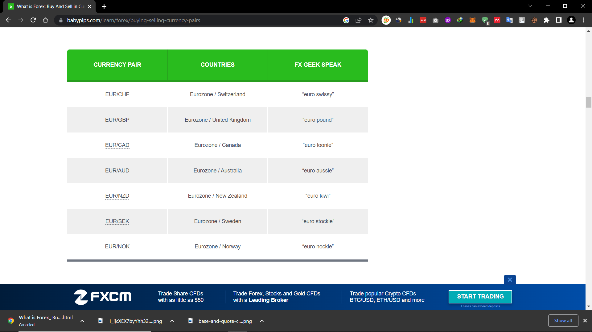
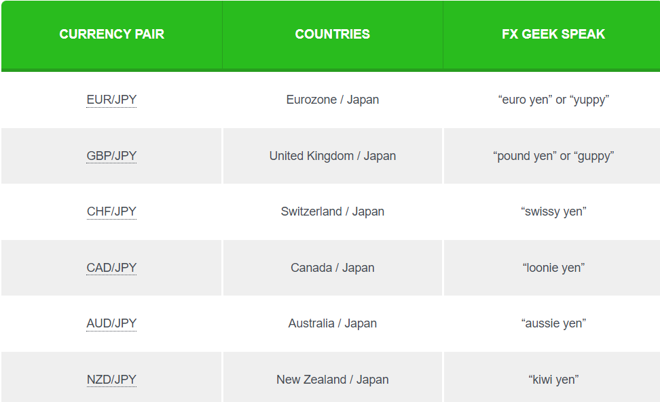
02)Minor Currency Pairs
Currency pairs that include any two of the major currencies except the U.S. dollar are known as cross-currency pairs or simply as the “crosses.”
Euro crosses -
Yen crosses -

Slide 4
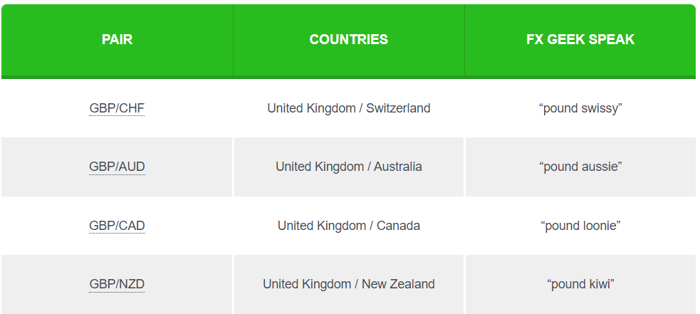
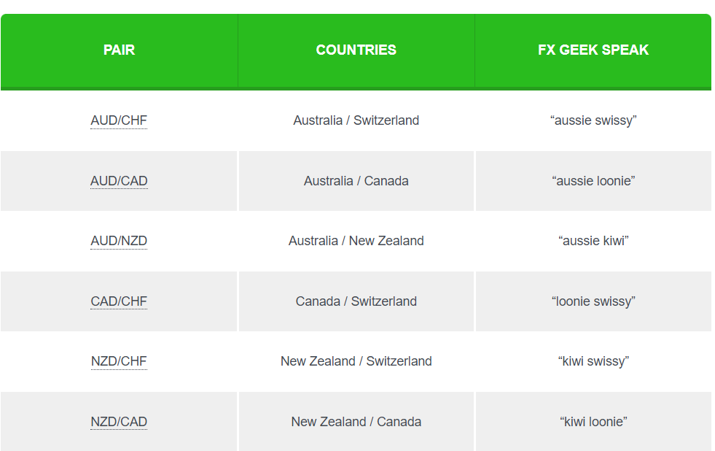
Pound Crosses -
Other Crosses -

Slide 5
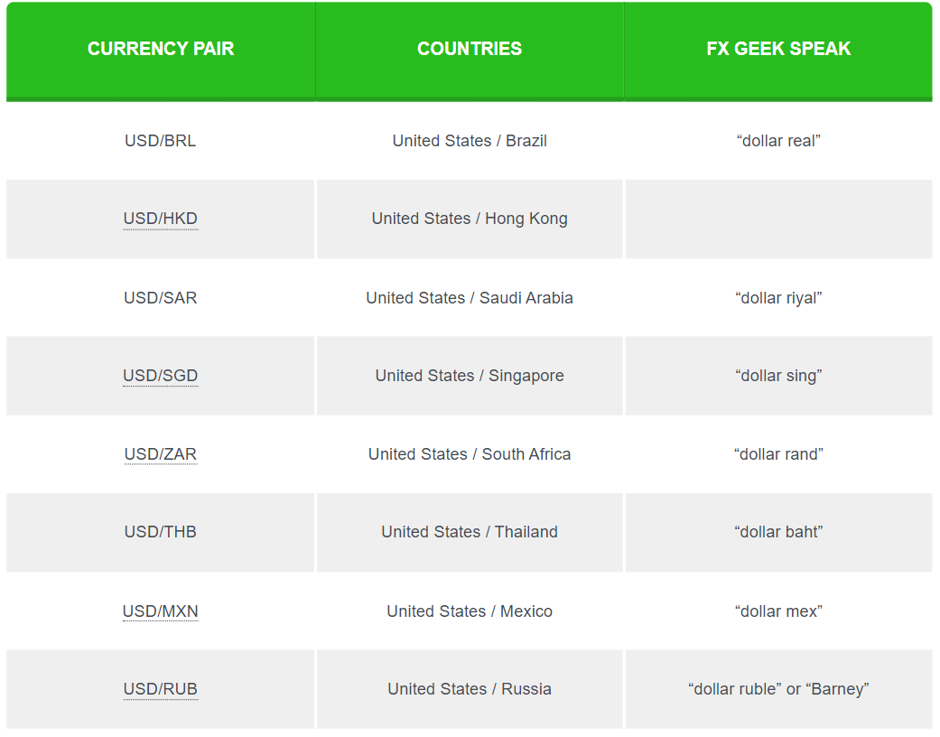
03)Exotic Currency Pairs
Exotic currency pairs are made up of one major currency paired with the currency of an emerging economy, such as Brazil, Mexico, Chile, Turkey, or Hungary.

